Slide 1
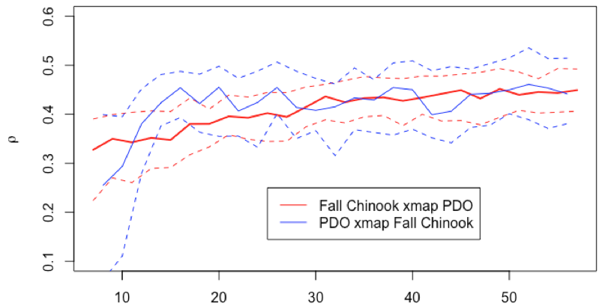
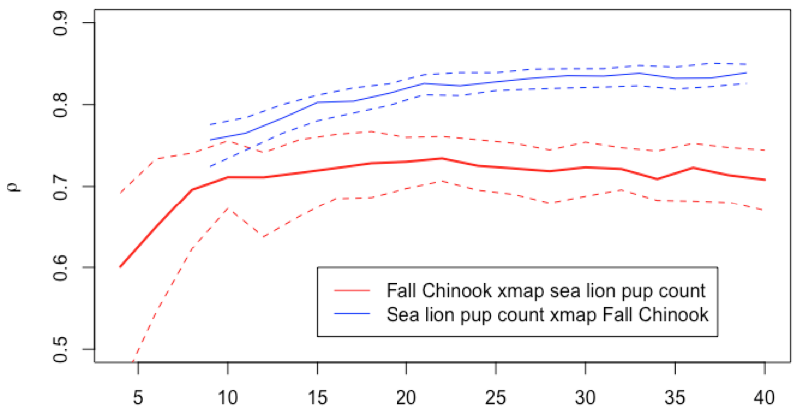
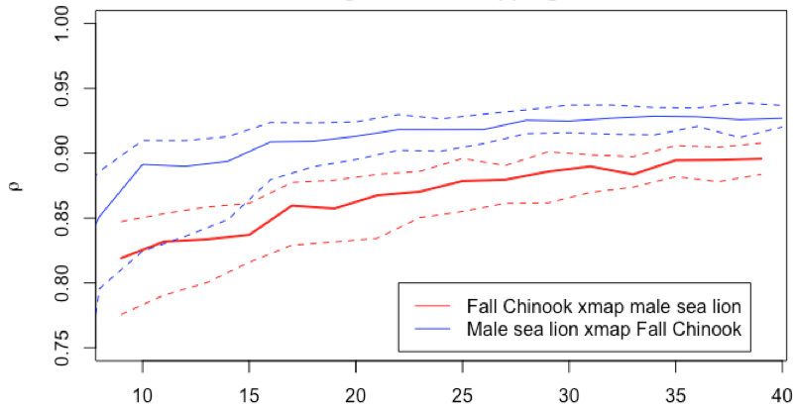
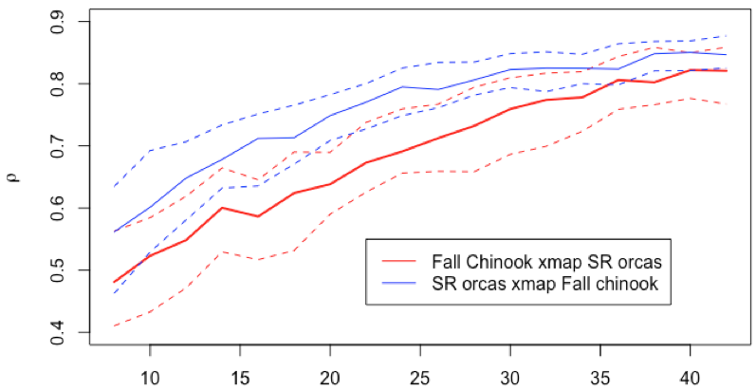
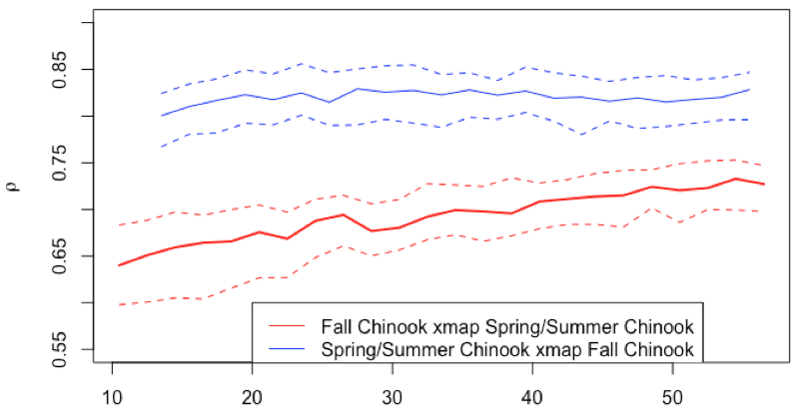
Convergent cross mapping (CCM) for Snake R. Fall chinook
Significant effect of PDO on IHR Fall chinook population dynamics (monotonic increasing trend in red) but no significant effect of chinook on PDO (in blue, as expected of course)
No significant effect of sea lion pup counts on IHR Fall Chinook (in red), but a significant effect of IHR Fall Chinook on sea lion pup counts (in blue).
Cross map skill, ⍴
Significant 2-way interaction between Fall Chinook and male sea lion population estimates
Significant 2-way interaction between Fall Chinook at IHR dam and the Southern Resident orca population
Significant effect of S/S chinook on Fall Chinook but not vice-versa.
Library size

Slide 2
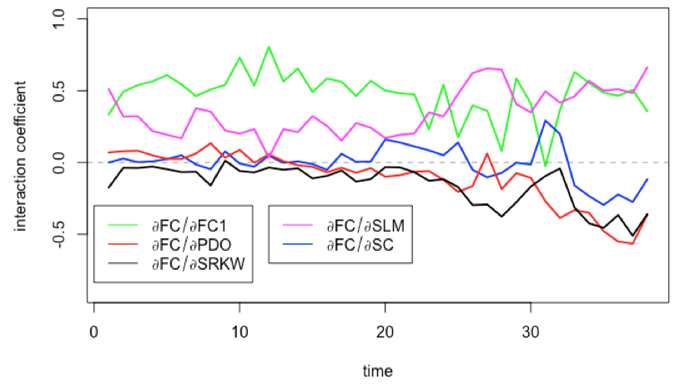
S-map interaction coefficients over time.

Slide 3
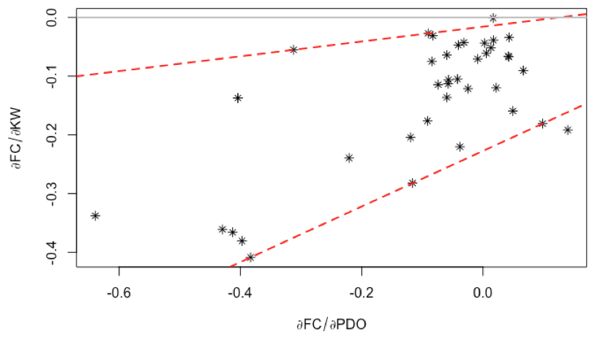
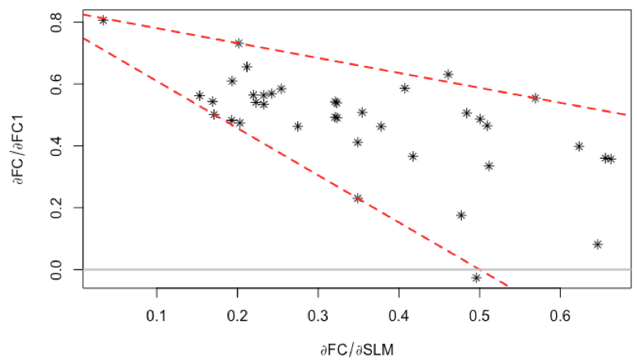
We can also plot the interaction coefficients relate to each other

Slide 4
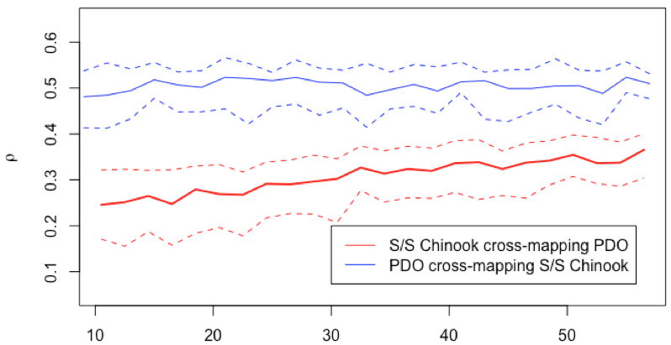
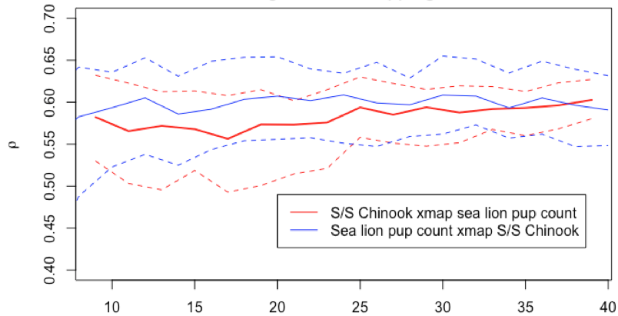
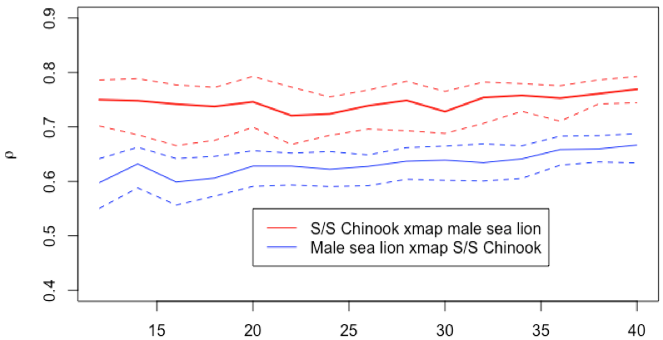
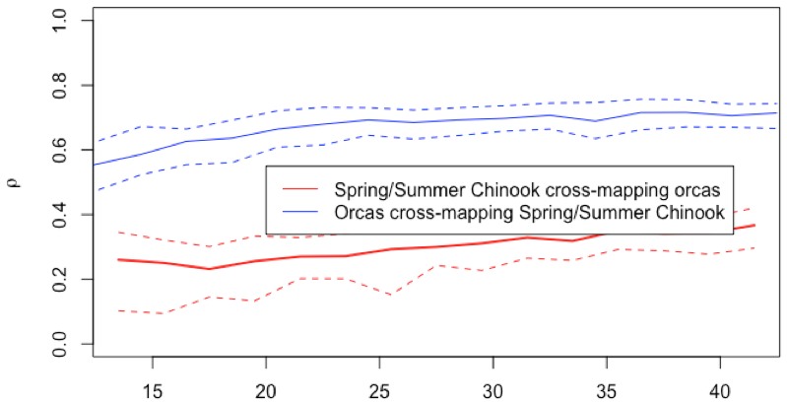
Convergent cross mapping (CCM) for Snake R. Spring/Summer chinook
Significant effect of PDO on IHR Spring/Summer chinook population size (monotonic increasing trend in red) but no significant effect of chinook on PDO (in blue, as expected of course)
Non-significant effects between sea lion pup-count and S/S Chinook
Significant effect of Spring/Summer Chinook on male sea lion population estimates but no significant effect of sea lions on S/S Chinook.
Significant 2-way interaction between Spring/Summer Chinook at IHR dam and the Southern Resident orca population. Although significant, this interaction seems less strong than that between Fall Chinook and orcas.

Slide 5
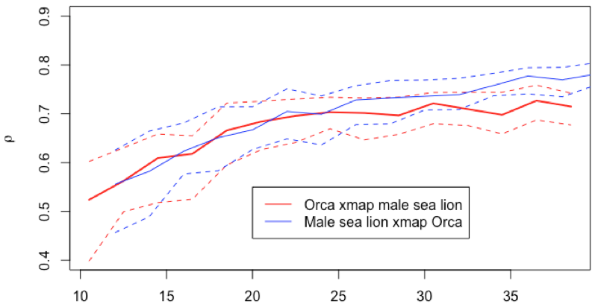
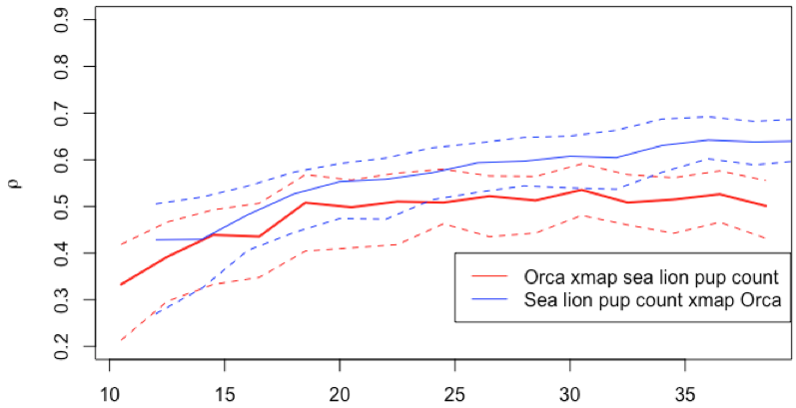
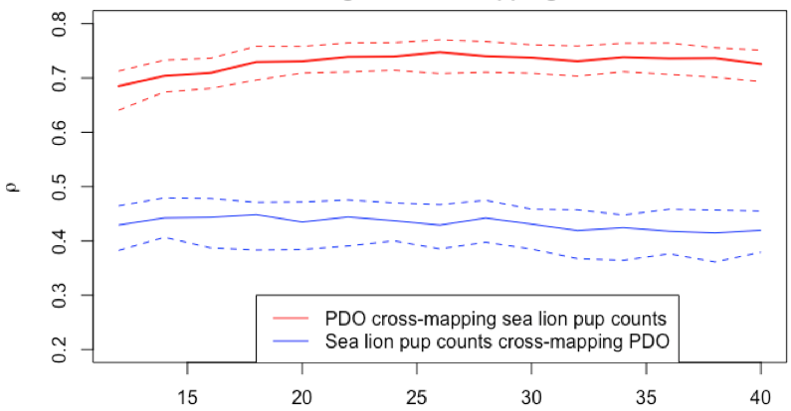
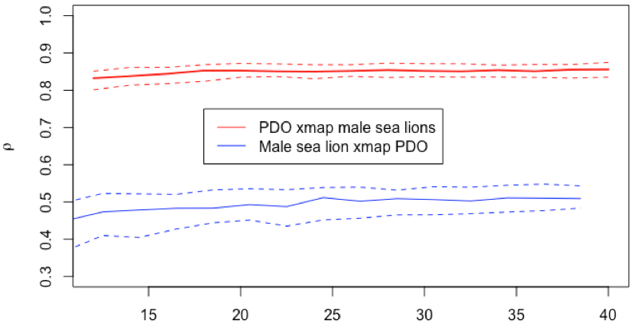
Cross mapping (CCM) between orcas, sea lions and PDO
Significant 2-way interaction between Orcas and male sea lions
Significant effect of Orcas on sea lion pup count but not of pup counts on orcas.
No significant effect of PDO on sea lion pup counts or on male sea lion estimates

Slide 6
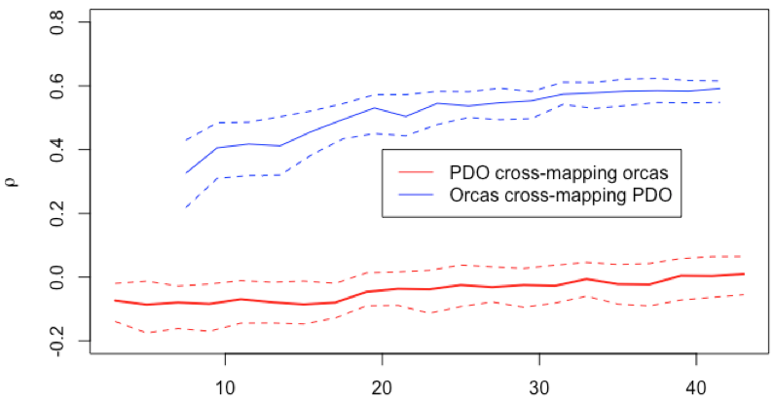
Both are significantly increasing, but only the effect of PDO on Orcas is significantly different from zero.

